Slide 1
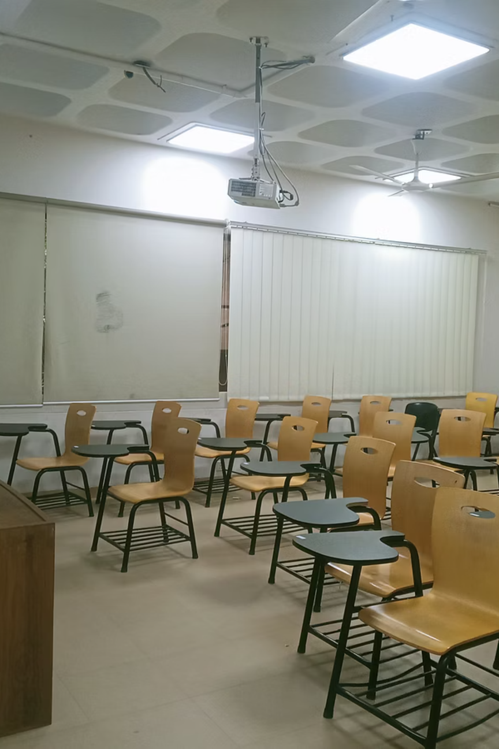
CSE 499A · SENIOR DESIGN 1
CampusEye
AI-Based Classroom Photo Attendance Management System Using Face Recognition
Group 7
Team members:
Md. Rizvi Ahmed 2221719042
Safayat ibrahim 2131174642
Rafiqul Islam 2122414642
Md. Arebi Sarkar 2221362042
Supervisor:
Mohammad Shifat-E-Rabbi · North South University
Notes:
1

Slide 2
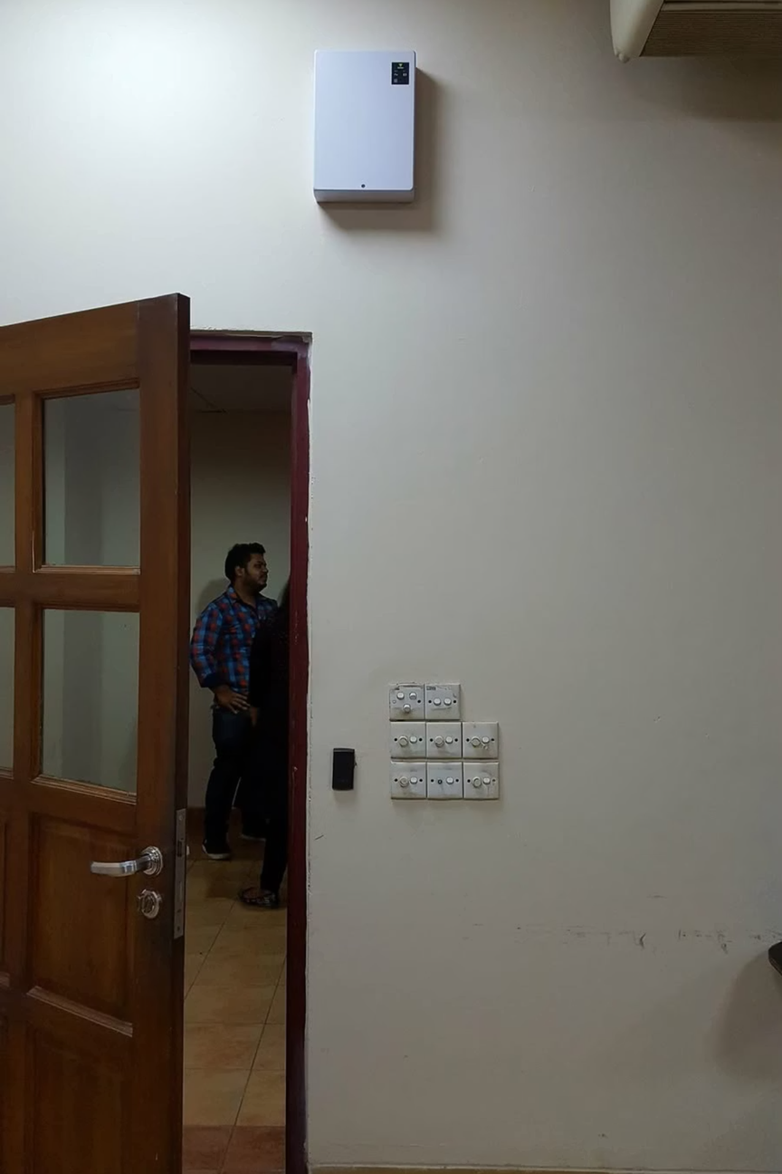

The Existing System at NSU
Currently, every NSU student carries an RFID card. Upon entering the classroom, they scan the card on a wall-mounted sensor, and attendance is automatically recorded in the university's central system aka. RDS.
Notes:
2

Slide 3
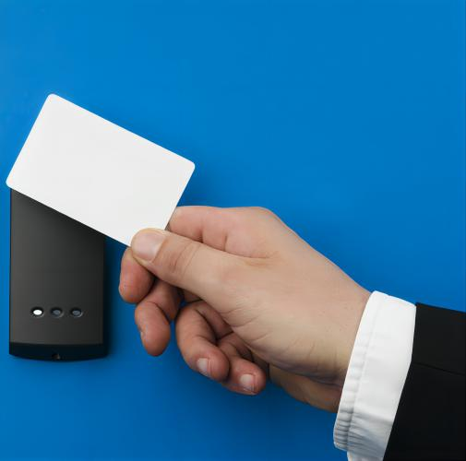
Limitations of RFID Attendance Systems
Card dependency: Students who forget or lose their RFID card cannot mark attendance, even if physically present in class.
Proxy punching: Classmates can easily scan a card on someone's behalf, undermining the integrity of attendance records.
Time-consuming: A queue forms at the sensor in large sections, eating into valuable lecture time.
Hardware Maintenance: RFID readers require installation, maintenance, and occasional replacement due to wear and technical issues.
No real-time verification: The system cannot confirm whether the card owner is actually inside the classroom.
Notes:
3

Slide 4

Our Proposed Solution
Instead of punching an RFID card, the class teacher captures a single photo of the entire classroom from the front. The image is sent to our application where an AI model detects every face using facial recognition and matches it against a pre-registered database stored in the backend.
01
02
03
Teacher Captures Photo
AI Detects & Matches Faces
Attendance is Recorded
The instructor takes a photo of the classroom using any device — phone, tablet, or laptop camera.
The software detects each face and compares it against the student database in the backend.
Matched students are marked present automatically; unmatched students are marked absent after the time window closes.
Notes:
4

Slide 5

Key Challenges & Our Solutions
Building a reliable facial-attendance system comes with real engineering and ethical challenges. Below are six critical "W" and "H" questions we must address, along with how we plan to tackle each one.
Notes:
5

Slide 6


Technical & Ethical Problem Statements
1
2
3
What about privacy?
How accurate is face detection?
What if a student arrives late?
Student facial data is sensitive biometric information.
Solution: We will encrypt all facial embeddings at rest and in transit, restrict database access via role-based permissions, and design the system for on-campus deployment so data never leaves NSU servers.
Poor lighting, angled faces, and partial occlusion can reduce recognition accuracy.
Solution: We will train on diverse datasets, apply image pre-processing (contrast enhancement, alignment), and fine-tune detection thresholds through iterative testing in real NSU classrooms.
A rigid cutoff could unfairly penalize students. Solution: The system will include a configurable grace period — defaulting to 20 minutes — after which any unmatched student is automatically marked absent.
4
5
6
How do we handle proxy attendance?
Where do we get training data?
How will the app run across devices?
Unlike RFID, faces are difficult to fake — but twins or look-alikes could cause false positives. Solution: We will use deep metric learning models that map faces to high-dimensional embedding spaces, significantly reducing misidentifications among similar-looking individuals.
Pre-built datasets may not reflect NSU's student demographics, impacting accuracy.
Solution: We will combine public datasets like LFW with a locally collected dataset of consenting NSU students, captured under real classroom lighting conditions.
Teachers use different platforms — PC, Mac, and phones.
Solution: We will build a responsive cross-platform frontend and a cloud-backed REST API, ensuring consistent performance regardless of the device used to capture or review attendance.
Notes:
6

Slide 7
Technology Stack & Tools
Backend & AI Layer
Frontend & Deployment
Python · Flask
REST API & server logic
OpenCV
Face detection & preprocessing
FaceNet / dlib
Facial embedding & recognition
MySQL / PostgreSQL
Student & attendance database
React.js / Flutter — Cross-platform UI for PC, Mac, and mobile
Firebase / Docker — Deployment and containerized hosting
Git & GitHub — Version control and team collaboration
Figma — UI/UX prototyping and design
Postman — API testing and documentation
Notes:
7

Slide 8

Dataset Collection Strategy
Students register their profile before using the system during the admission.
Multiple facial images (5–10) will be captured from different angles and expressions in suitable lighting condition.
Notes:
8

Slide 9
Expected Outcomes
Automated attendance recording
Photos processed into reliable attendance logs with timestamps and confidence metrics.
Time savings
Significant reduction in class time lost to manual roll-calls and administrative overhead.
Accuracy & fraud reduction
Lower incidence of proxy attendance through identity verification and confidence thresholds.
Usable dashboard and reports
Faculty can review, correct, and export attendance data for record-keeping and analytics.

Slide 10

Future Scope
Version 2: Hybrid RFID + face verification to combine convenience and stronger anti-proxy checks.
Version 3: CCTV-based continuous monitoring and real-time alerts for absenteeism patterns.
Mobile app for student self-check and push notifications for attendance status.
Advanced analytics: longitudinal attendance trends, at-risk student detection, and integration with LMS.

Slide 11
Thank You
We are a team of five NSU CSE students passionate about applying AI to solve real campus challenges. This project represents our CSE 499A planning phase, and we welcome feedback from classmates and faculty to refine our approach before implementation.
Notes:
10

